Slide 1
Provisio Capstone
Zach Griffin, John Moore, Jason Palmeri
Mishaela Pedersen, Scott Shannon

Slide 2
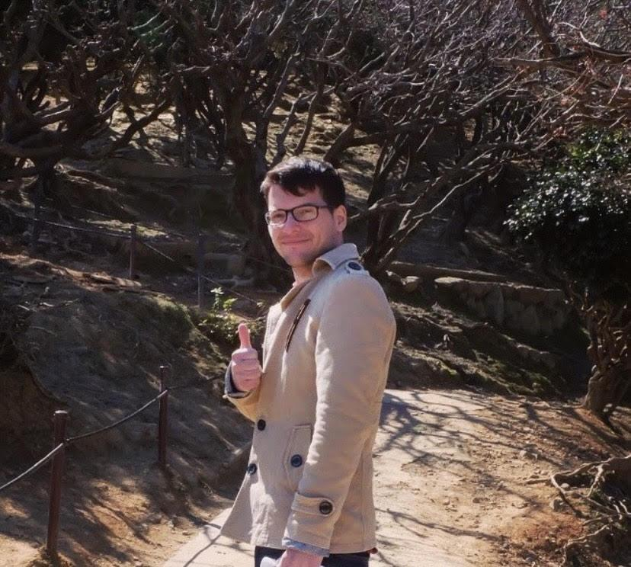
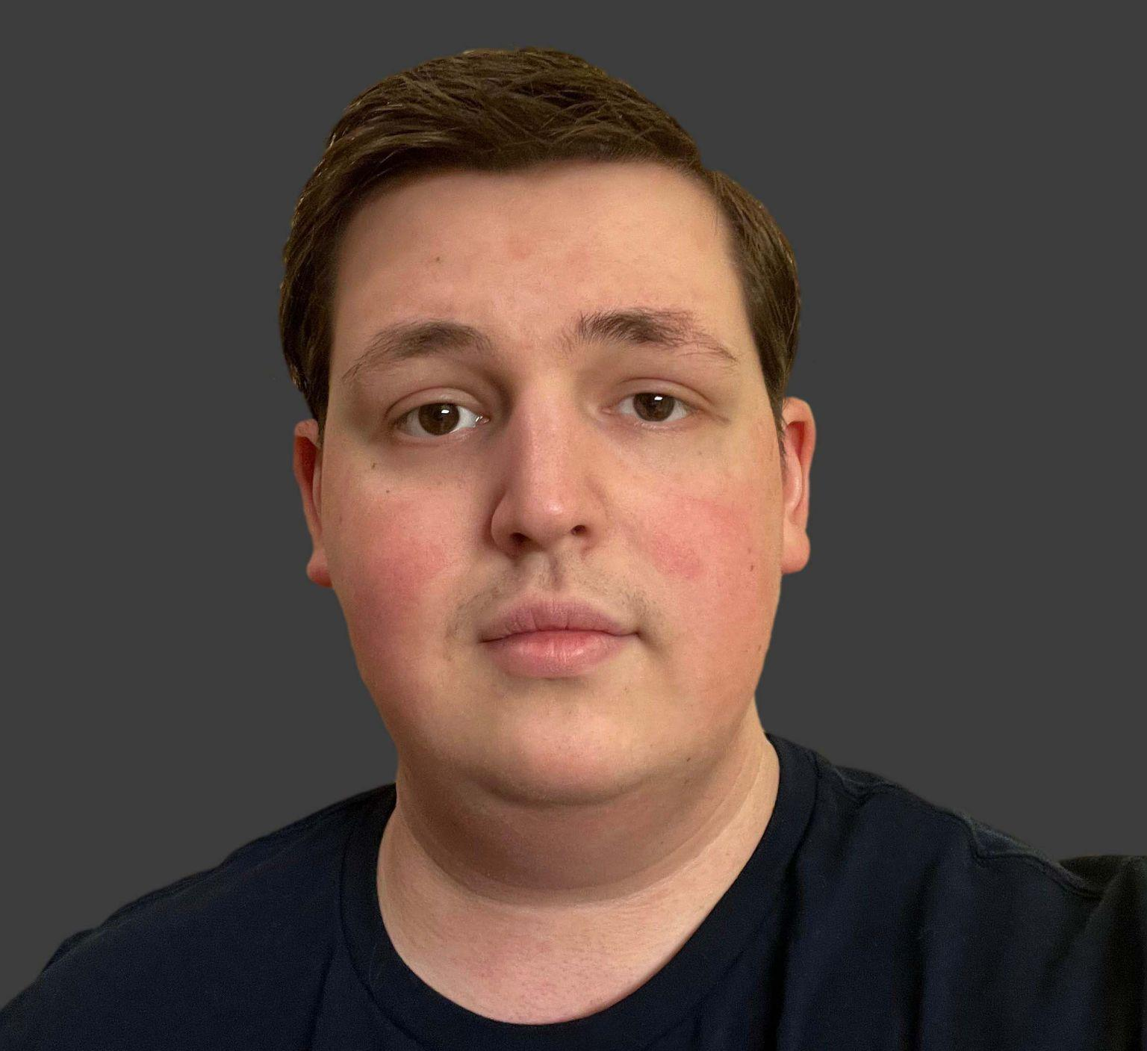
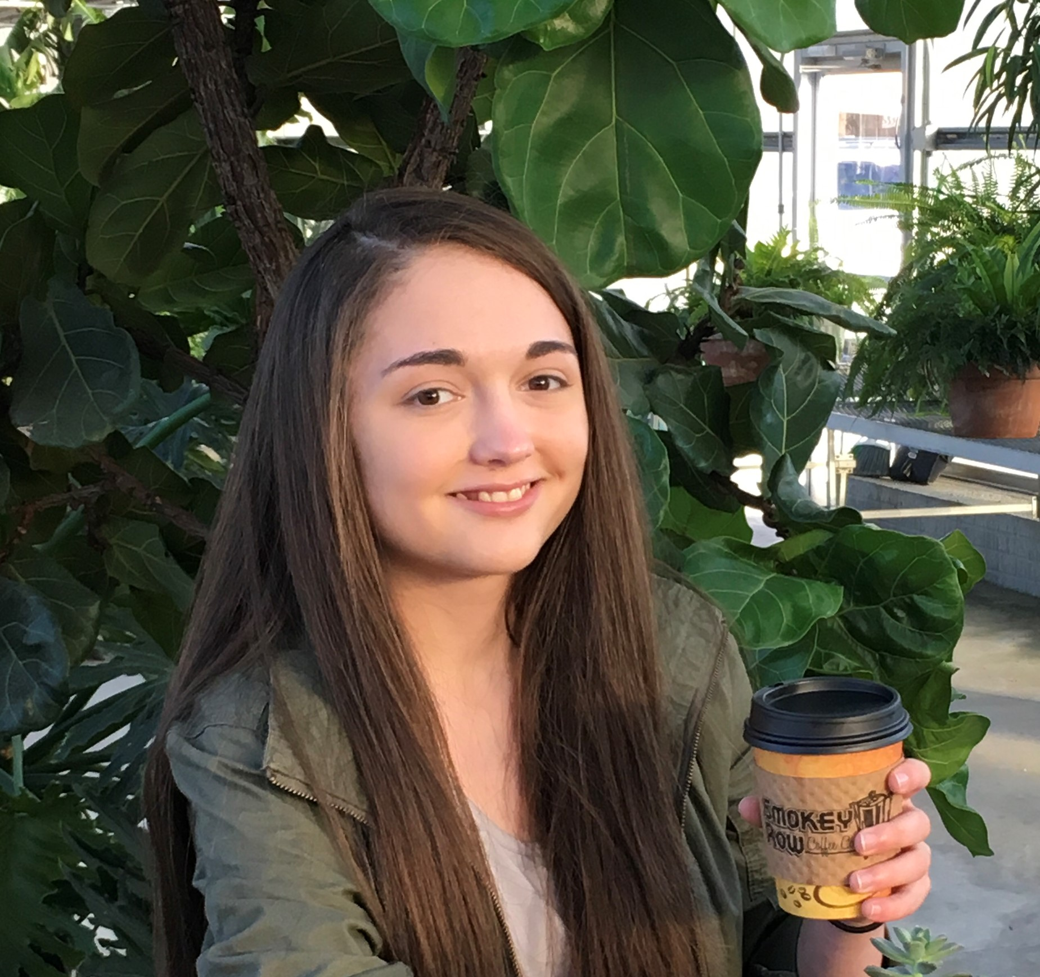
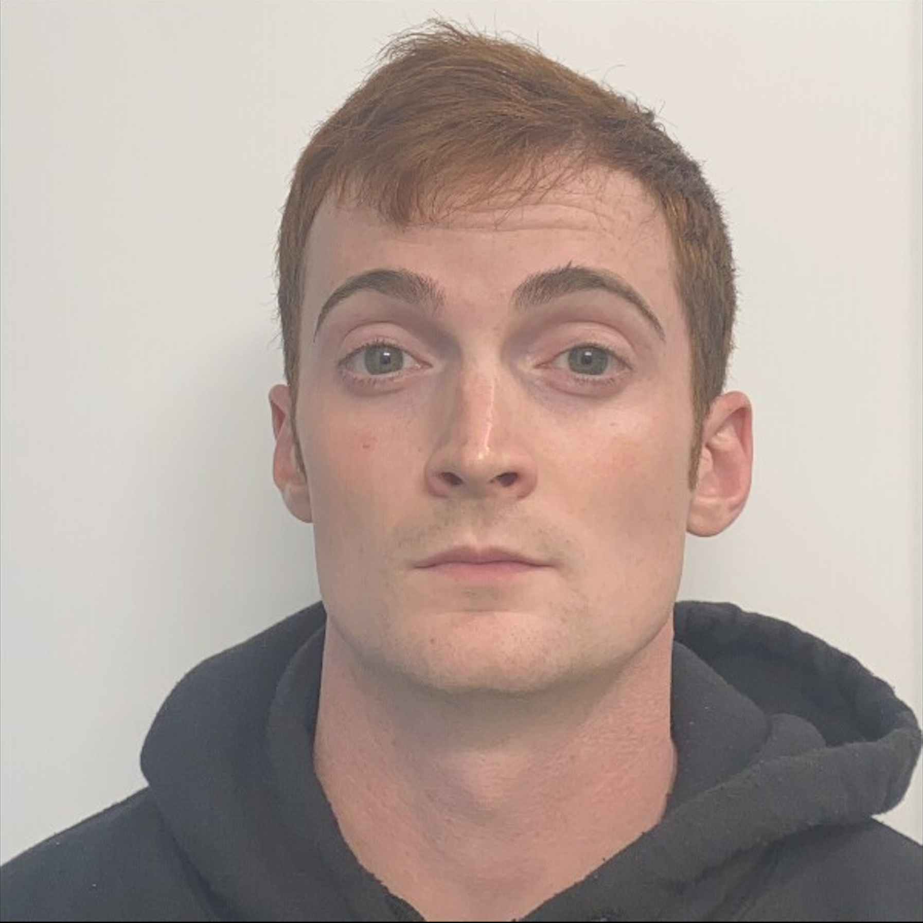
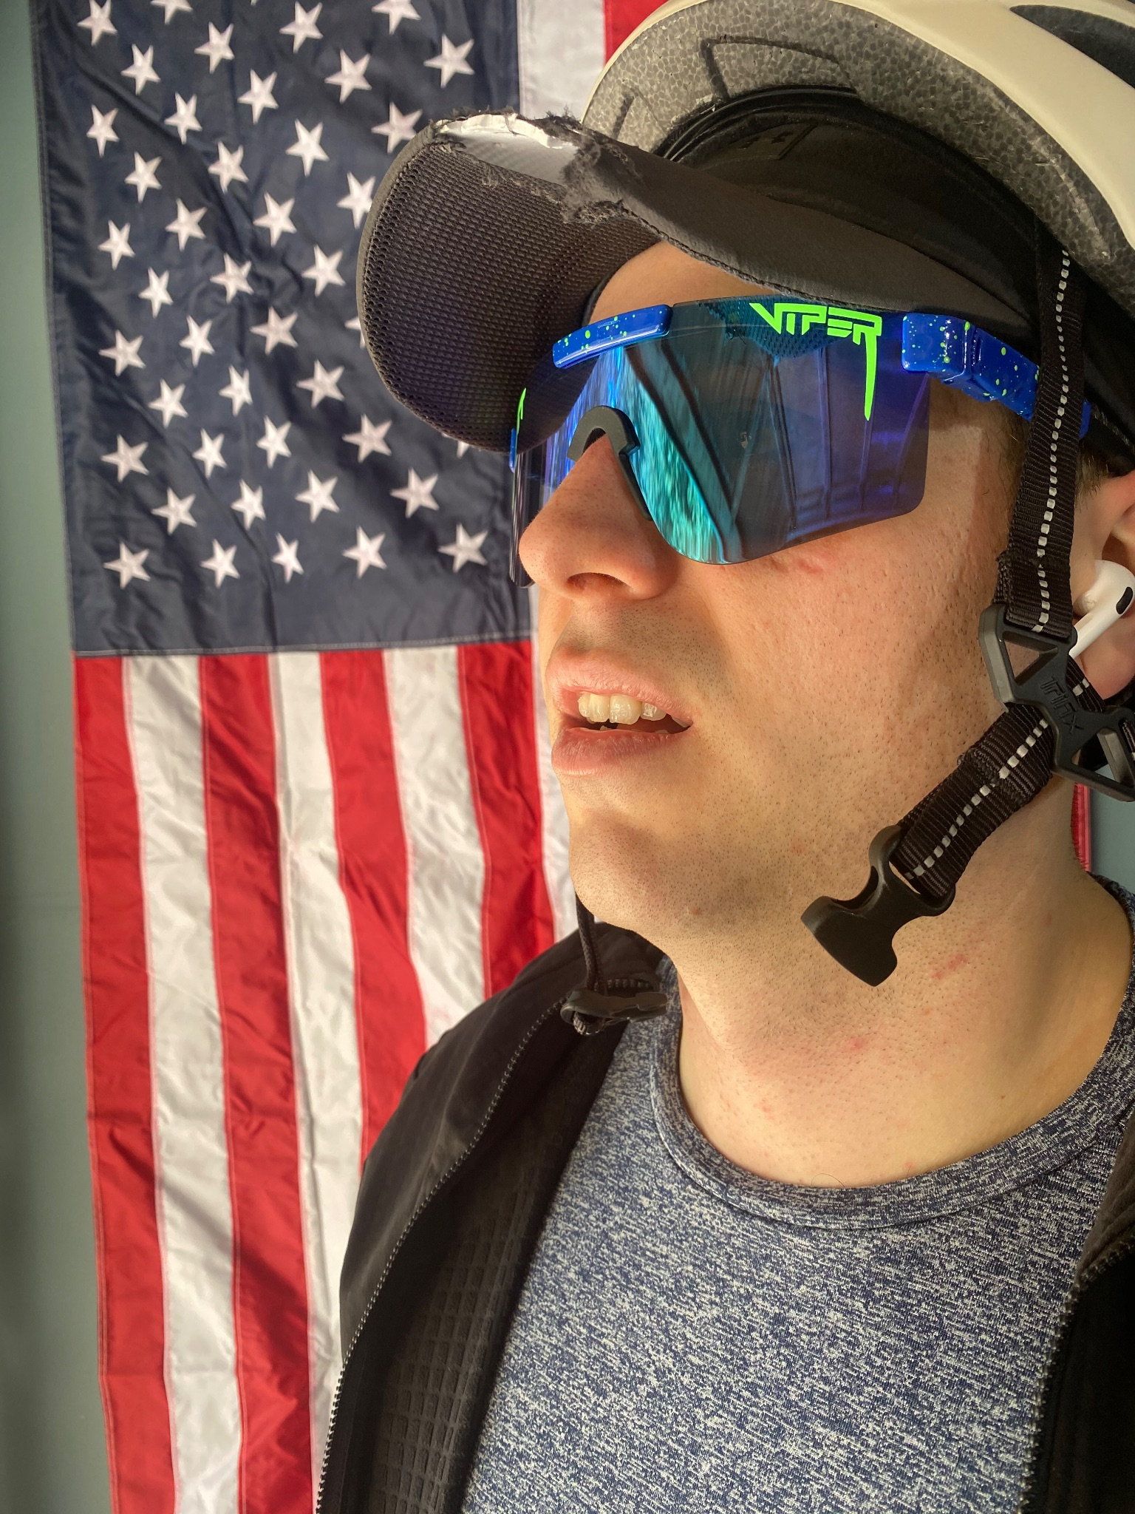
Zach Griffin
John Moore
Jason Palmeri
Mishaela Pedersen
Scott Shannon
Your img
Your img
Your img
Your img
During this project I have been playing a more supportive role in peer checking work, test cases and creating drafts of some pages, such as the about us page.
For this project I was tasked with being the Team Leader, I spent a majority of my time creating the front end pieces of the program and connecting the back end to the front end. As Team Leader I made sure that everyone knew what was going on and created a schedule for us all to follow.
I helped with the design aspect of project such as creating samples for color palettes and font choices. I also assisted with test cases and helped flesh out a few of the drafts of pages such as the About Us page.
This capstone was a lot of fun and I enjoyed working with the team. We had a larger group so I did not cover down on a specific lane, rather I helped out where I could. Our weekly team sync’s played a large role in keeping us from having blockers and allowed freedom of maneuver on weekly tasks.
Working with this team was a great advantage in this course. I have learned, struggled, and gained great allies that will guarantee I will succeed as a software developer. There were many challenges, but whenever I told my team about blockers they worked diligently to resolve them.

Slide 3
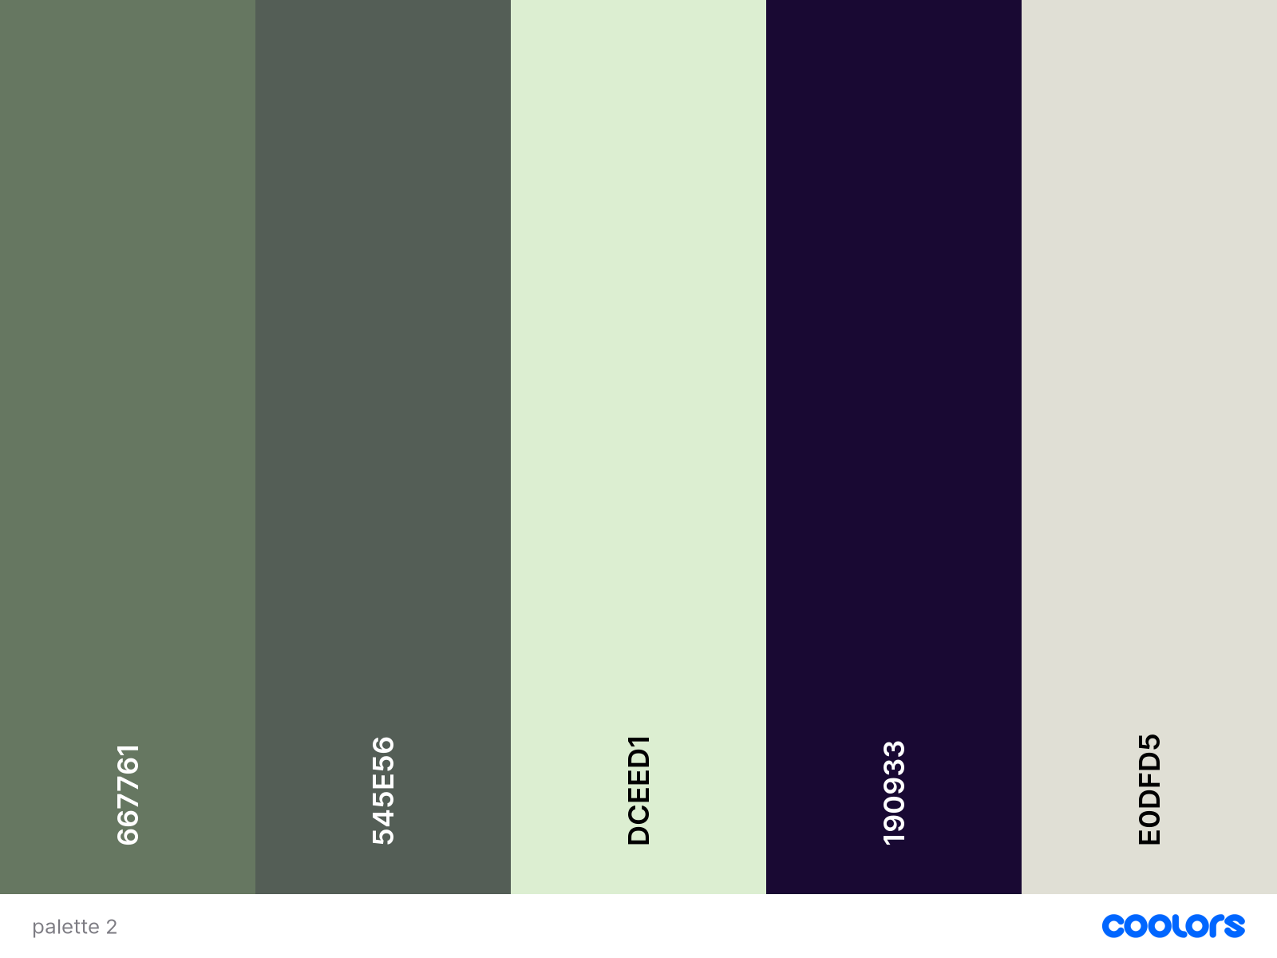
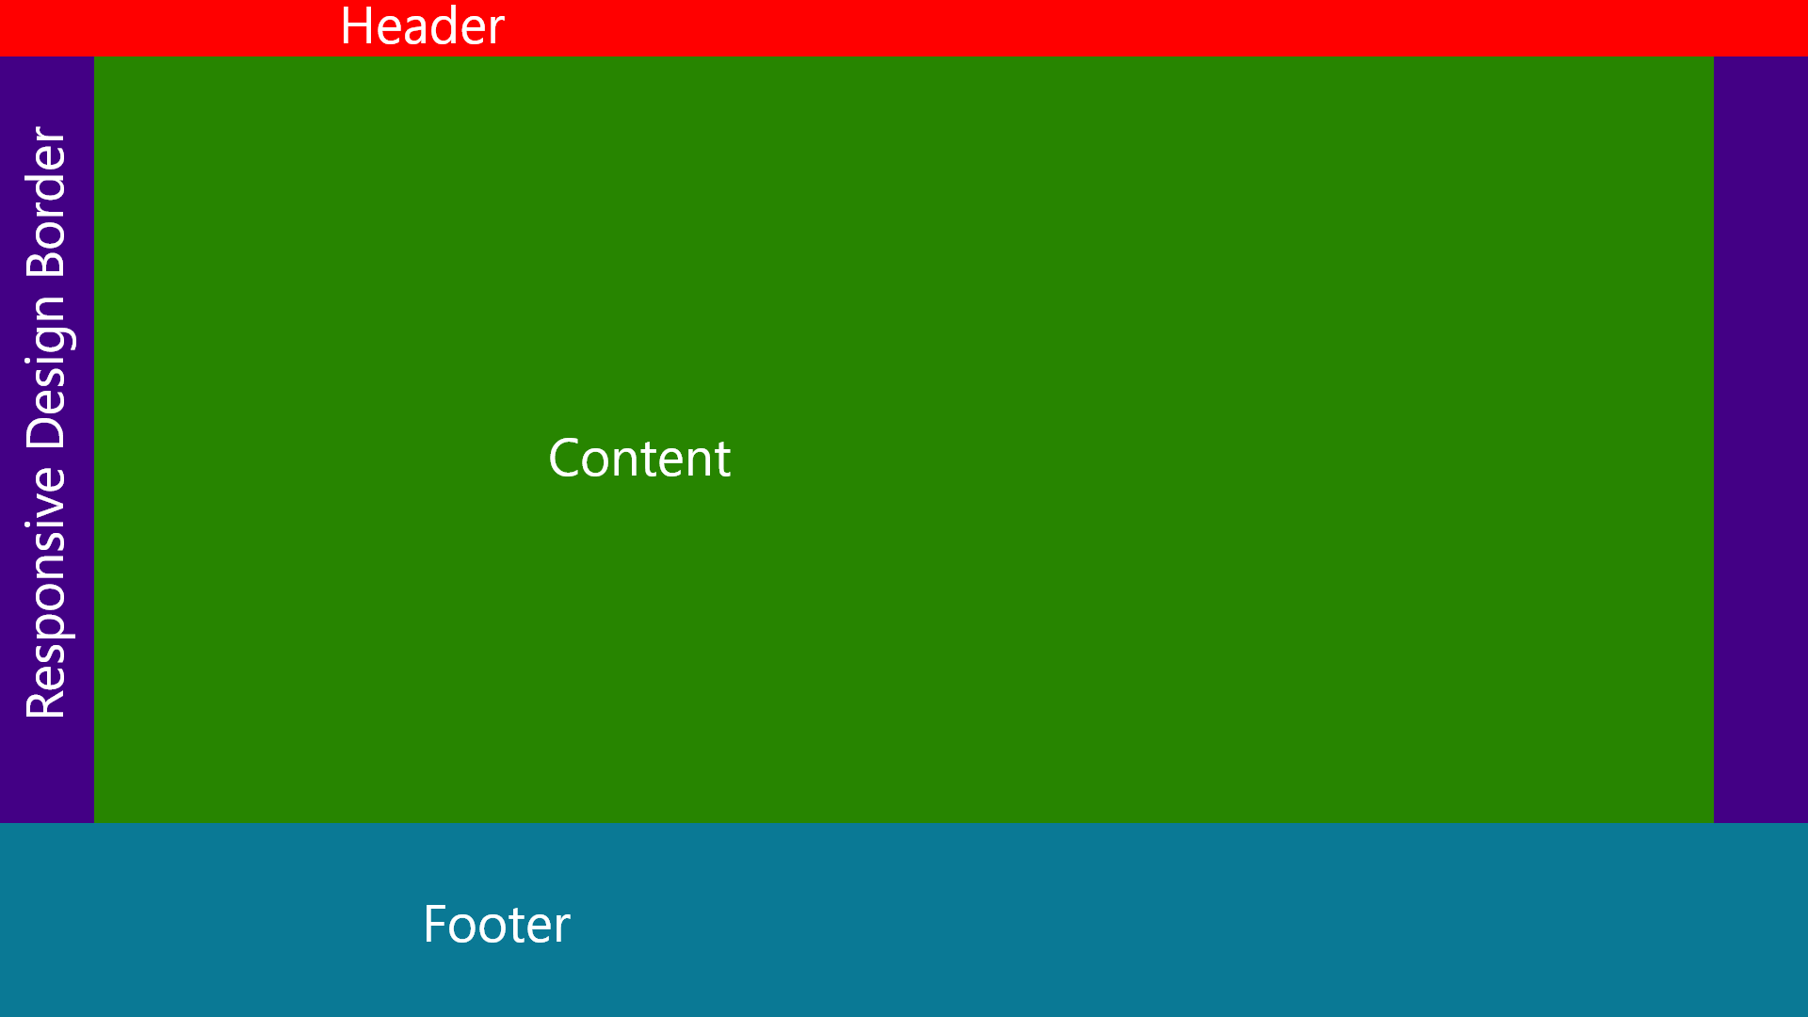
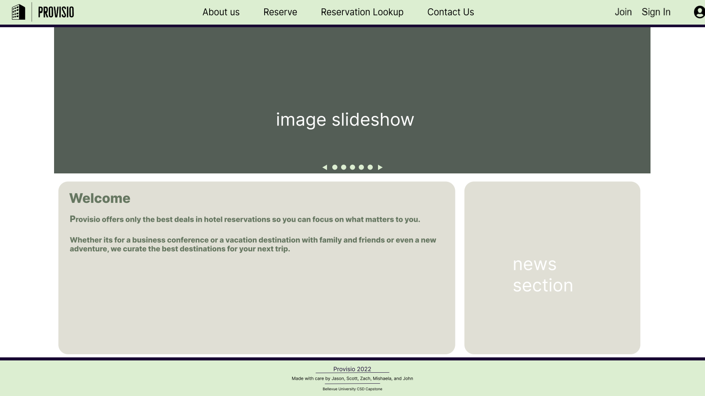
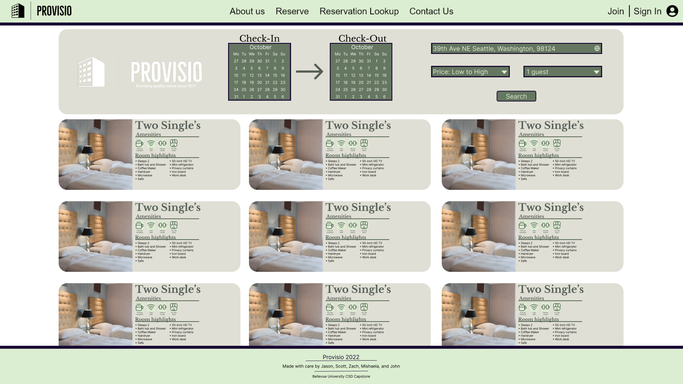
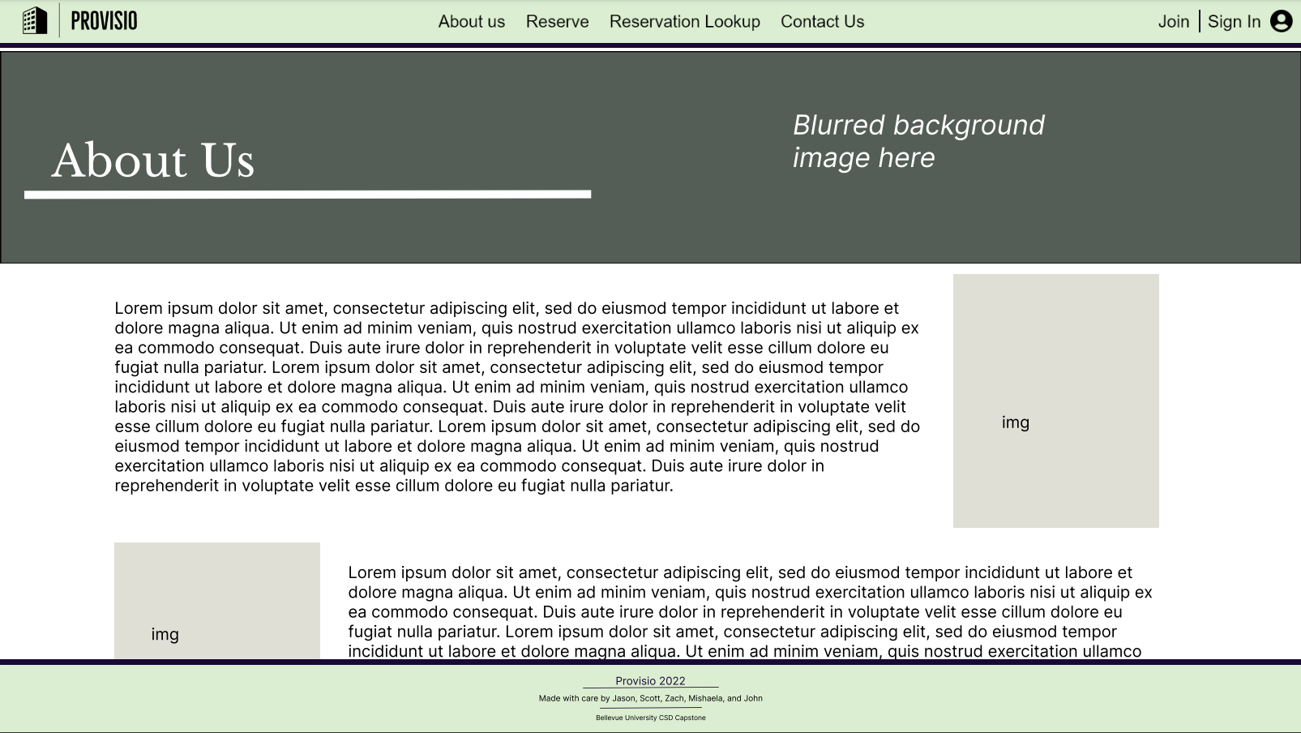
Prototypes
Color Palette
Original Template
Final Prototypes
Designed by John
Designed by Jason
Designed by Mishaela

Slide 4
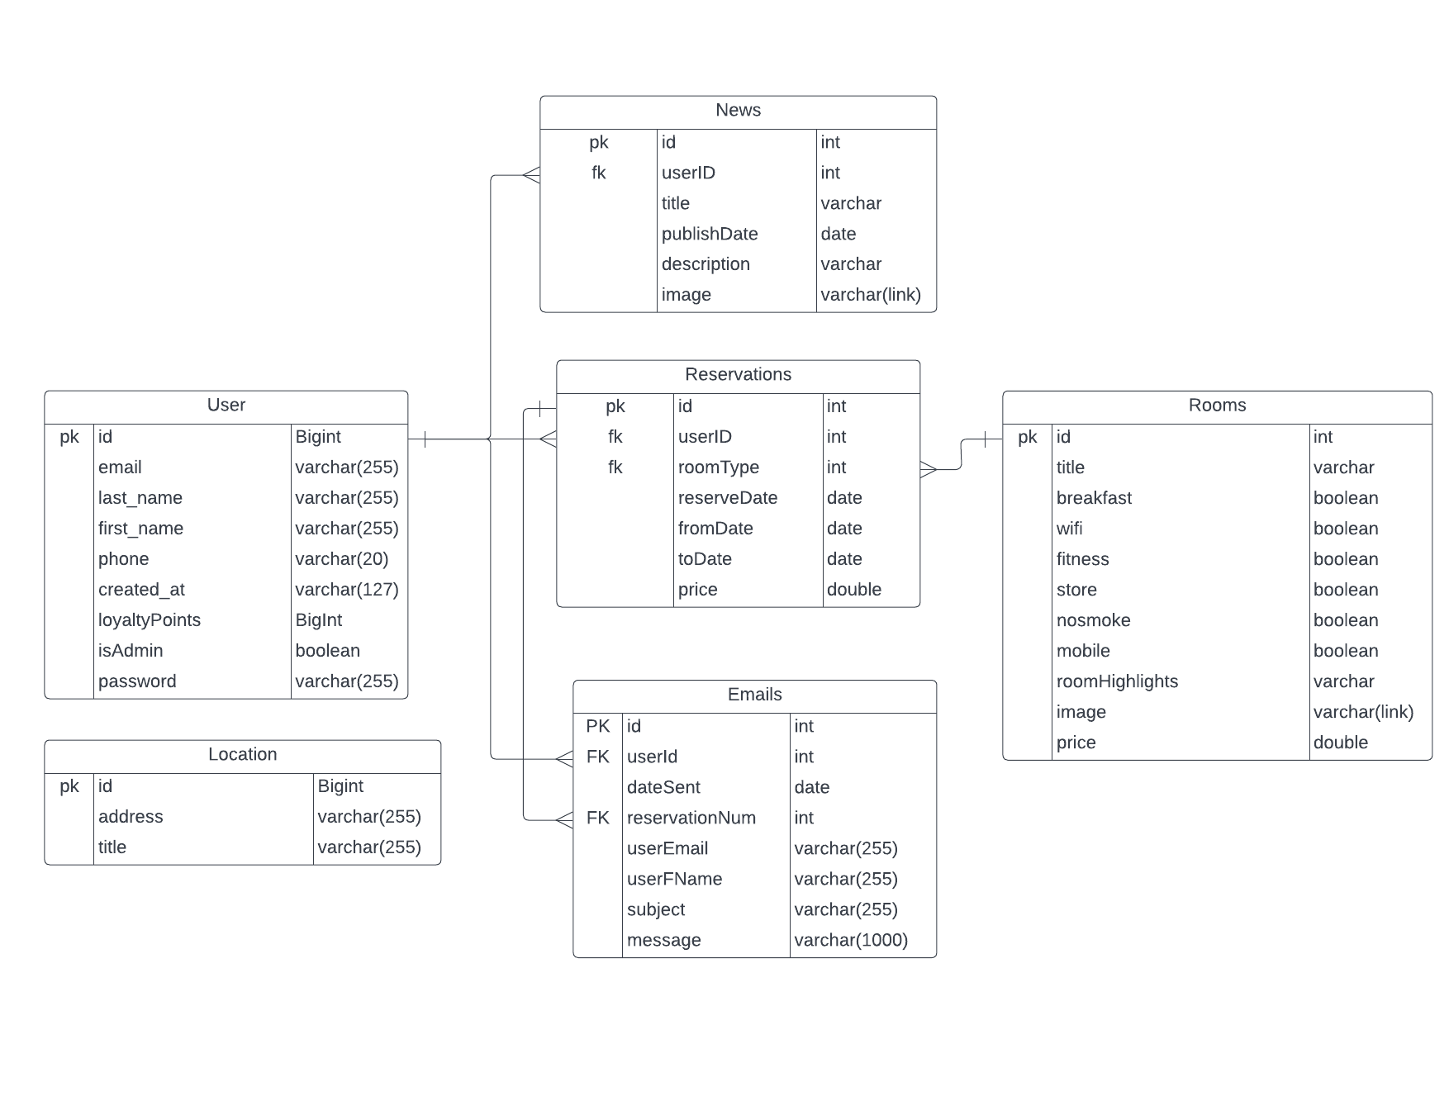
Entity Relationship Diagram

Slide 5
Tests
For each page that was assigned we created a standard set of items to test for each page
Accessibility
Functionality
Error Handling
For our testing of accessibility we wanted to make sure of a few things:
The Page was accessible by the right users
Ex: My Account page could only be accessed if you are logged in
The Page would redirect you to the correct page if you weren’t logged in or did not have access
Ex: Reservation page redirects you to log in page
For our testing of functionality we wanted to make sure that:
The page functioned correctly and that all links and buttons worked
Ex: Making sure that clicking on a reservation room opened the correct Modal
The page would stay in a stable state until something is clicked
The way most of our servlets respond to post requests is through AJAX, for example when logging in, if successful we setup a session and send a JSON string back with success:true which redirects you to the home page with the new session variable. To test our Error Handling we made sure that:
Errors popped up with invalid data requests
Ex: Entering invalid credentials at login or inavlid registration data
Errors popped up when something goes wrong on the back end
Ex: If there is an error cancelling a reservation the user would be notified to try again later

Slide 6
Lessons Learned
Things were a little rushed, towards the end of the project, mainly developing things like the loyalty points and reservations page, we realized that there were some things that were forgotten in our tables, mainly being that rooms should have a loyalty points field, and the reservations table needed fields for guests and locations.
Also while developing there were things that we wanted to add, mainly being a way to redeem the loyalty points, and a more fleshed out “Admin Panel”. At the end of the day I think planning for a project like this should take a little more thought than we had originally put into it.
This project really allowed us to learn a lot about actually developing a Java web site, John showed some amazing techniques to make sure everything was organized and easy to deploy. He was able to setup our project using Gradle and Docker and it made the whole process a lot easier to develop. John also showed us how to develop using “Repositories” which really broke down each Entity with basic database functions like insertOne() and getAll(), these really sped up the development process when connecting the back end to the front end.

Slide 7
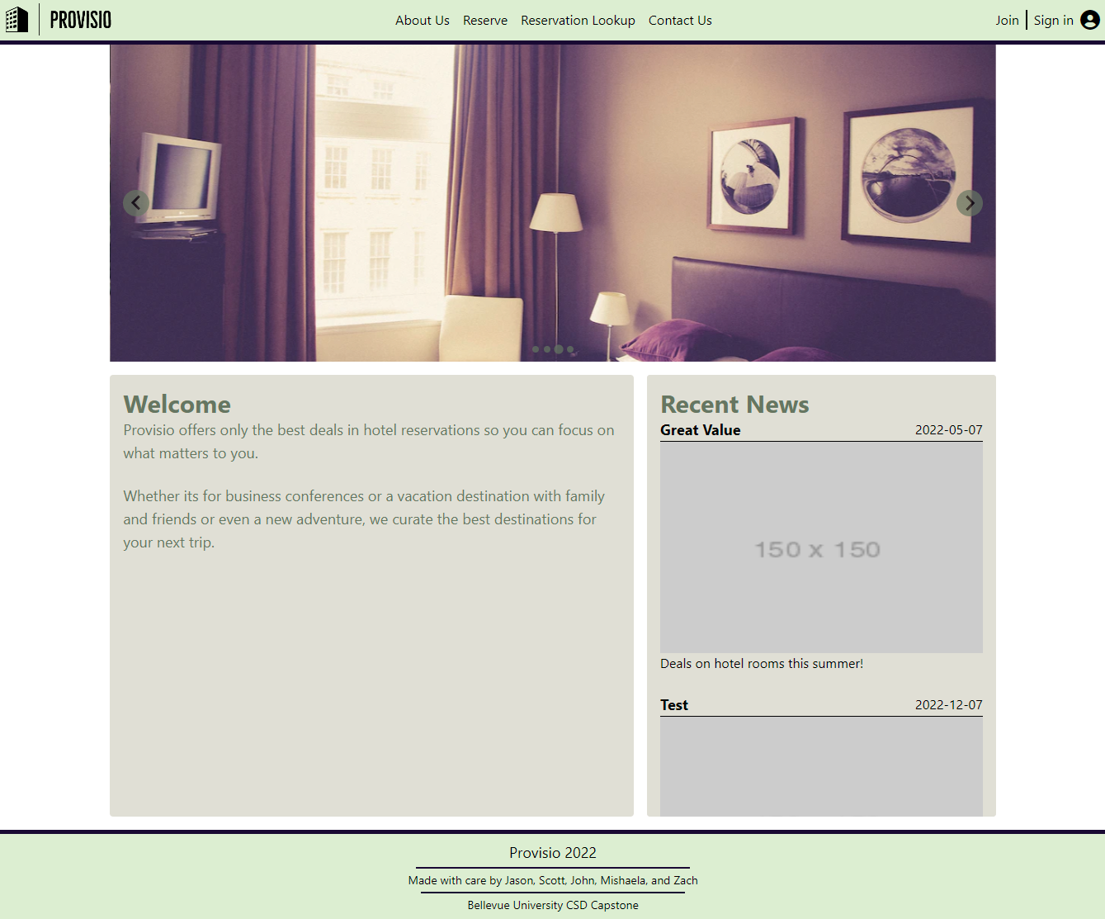
Landing Page
Designed by: John (Finalized By Jason)
The landing page features a slideshow, welcome message to users, and a news section that takes data from a MySQL table to display news articles

Slide 8
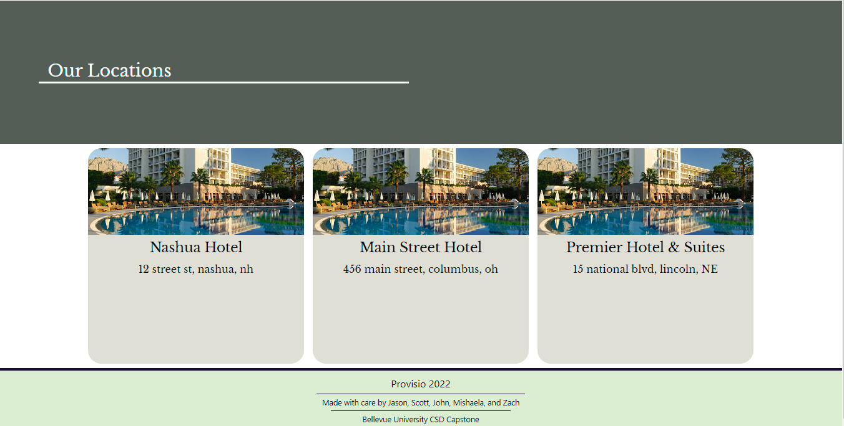
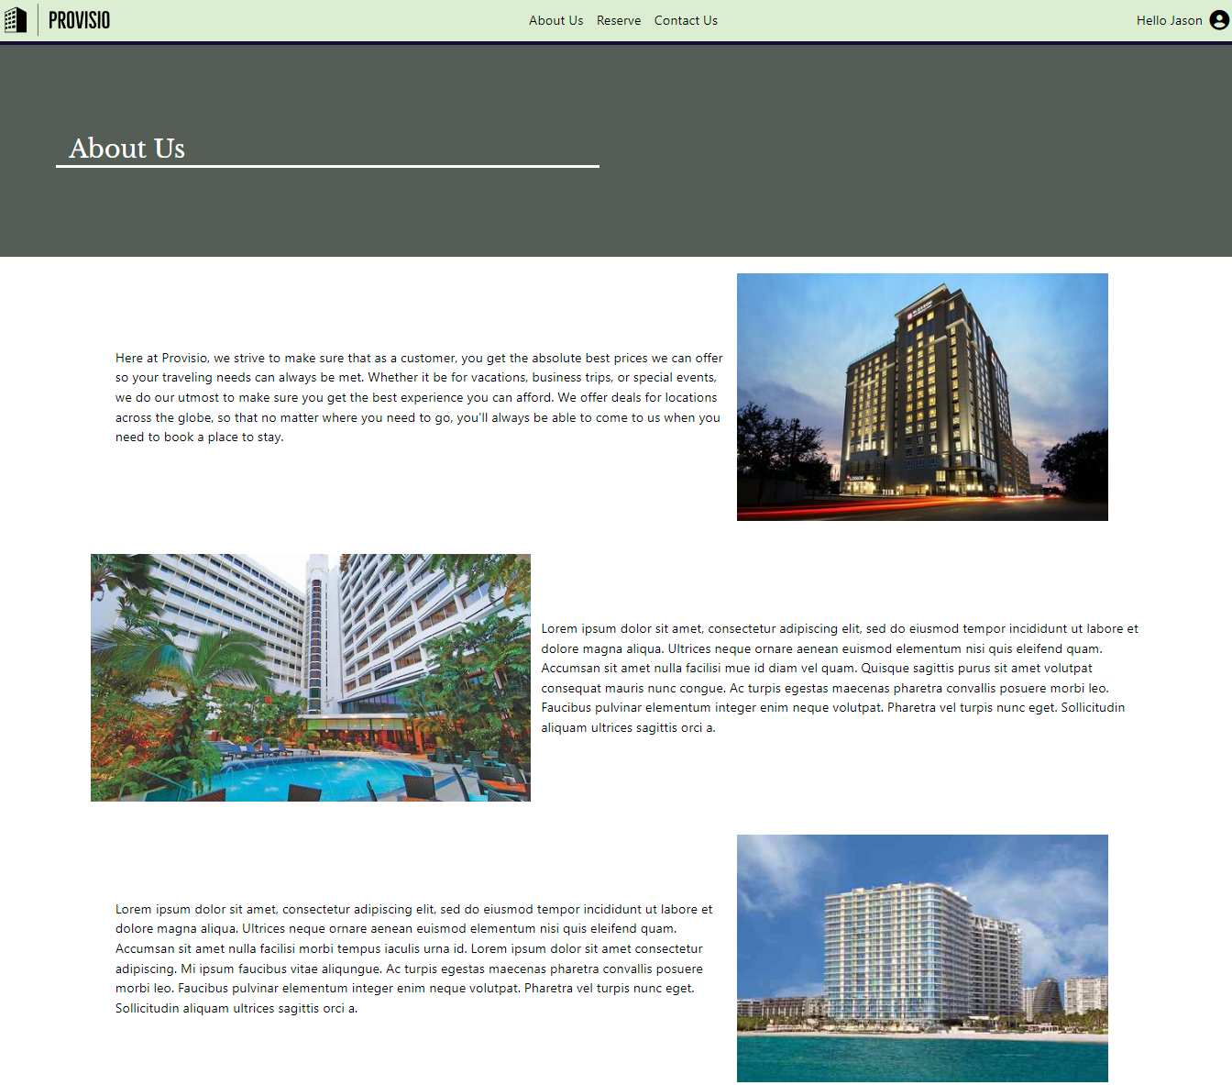
About Us Page
Designed by: Mishaela
The About Us Page has a few paragraphs about the company with images next to them. Towards the bottom we have a section highlighting our locations which are from the MySQL table

Slide 9
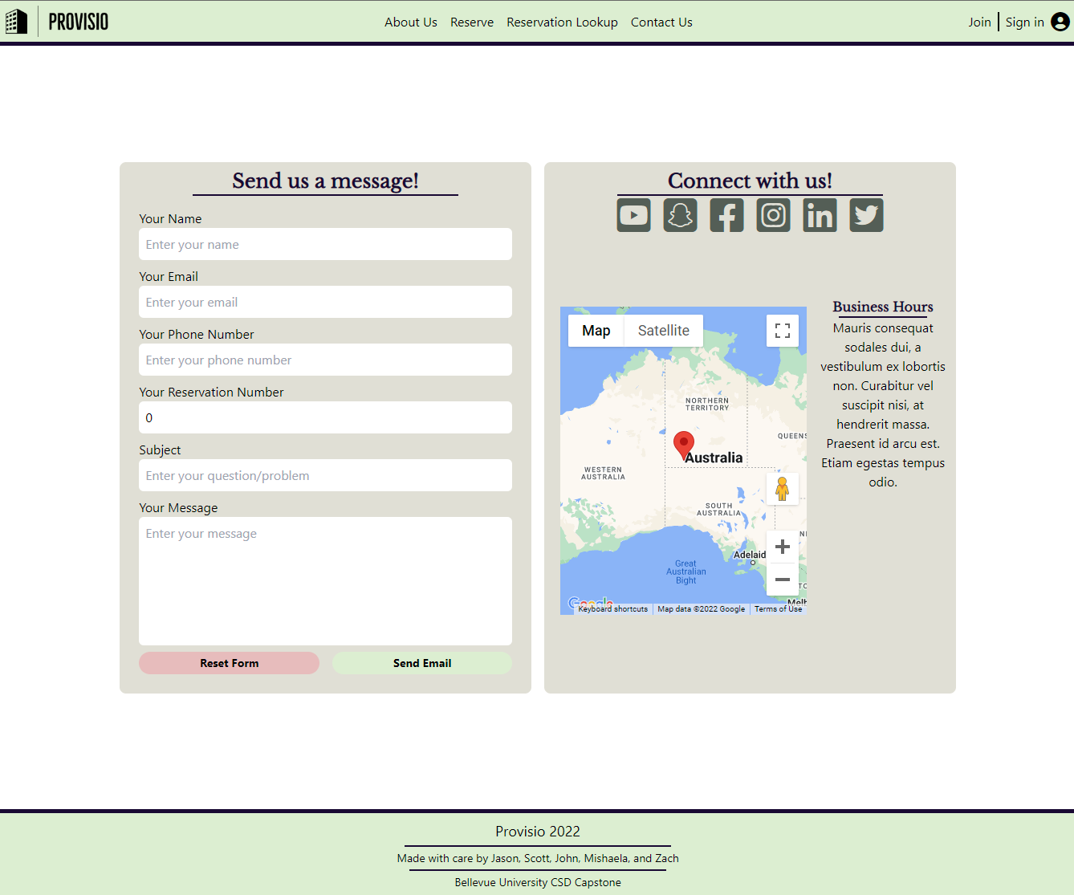
Contact Us Page
Designed by: Zach (Finalized by Jason)
The Contact Us Page features a simple contact form on the left, these messages are stored into a MySQL table. On the right there is a social media section with a map to the Provisio Headquarters

Slide 10
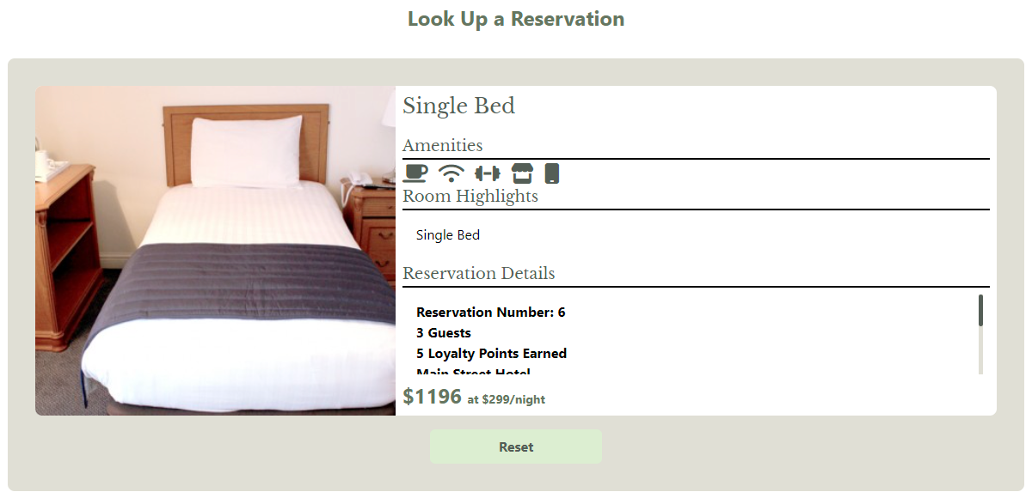
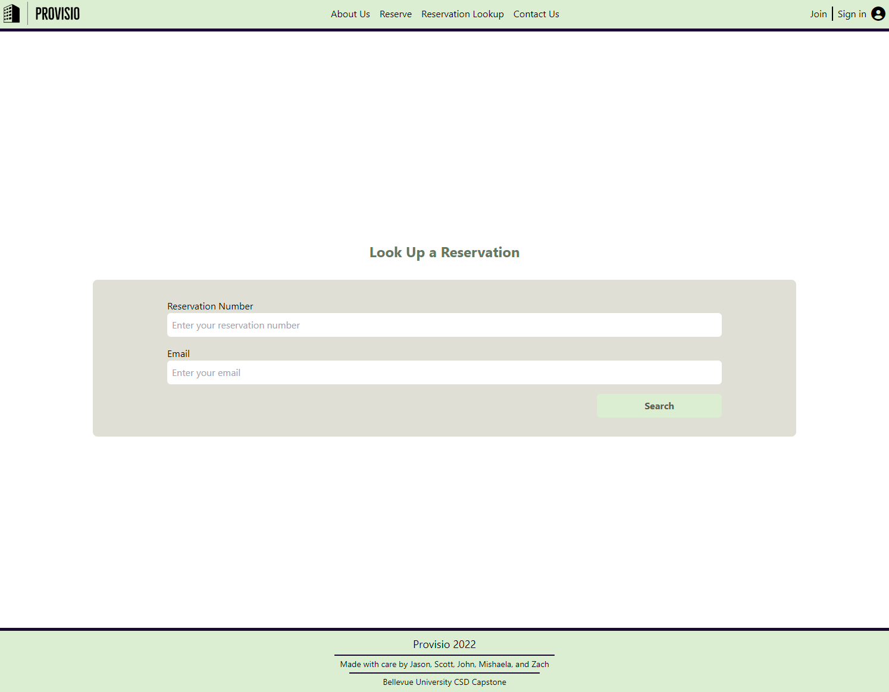
Reservation Lookup
Designed by: Scott (Finalized by John)
The Reservation Lookup Page allows non-logged in users to find their reservation by number and email. Upon submission you are greeted with a card of your reservation.

Slide 11
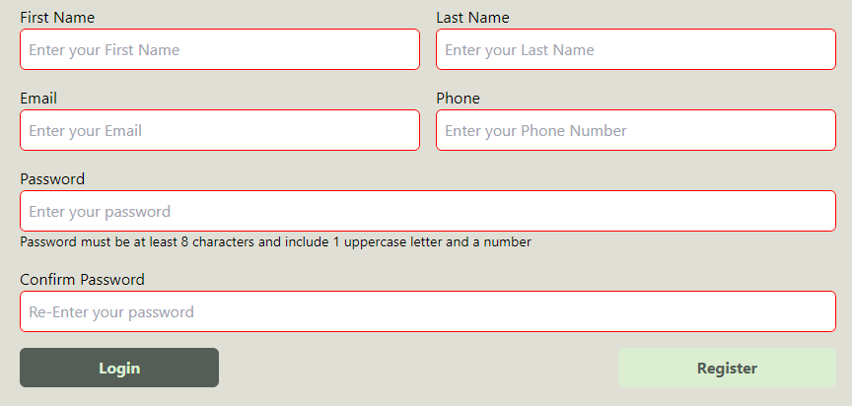
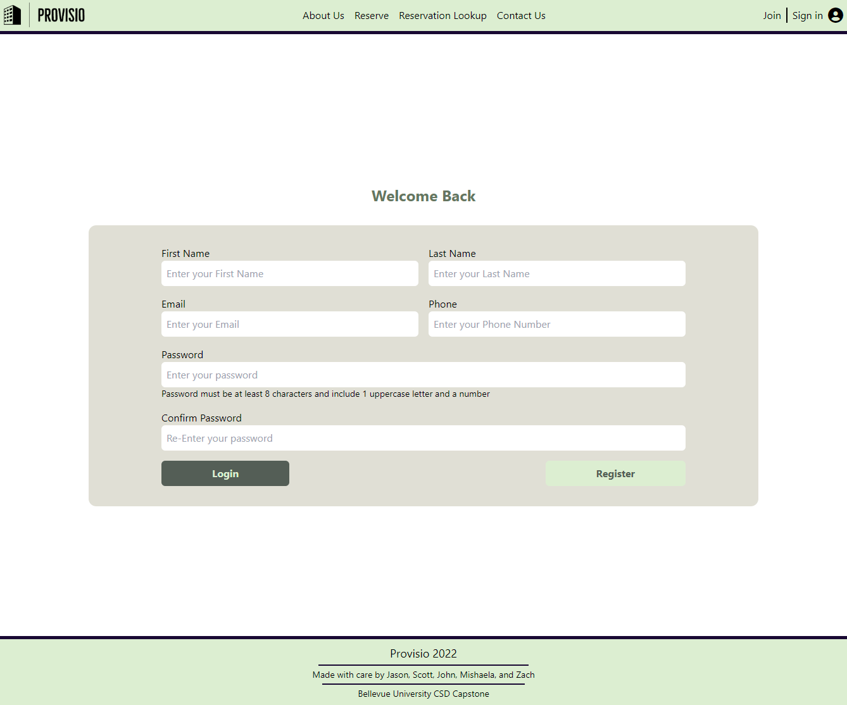
Register Page
Designed by: Scott (Finalized by John)
The Registration page features a simple form for creating a user account, providing details such as name, email, phone and password. Upon hitting “Register” with empty fields they get a red border to indicate that they are empty

Slide 12
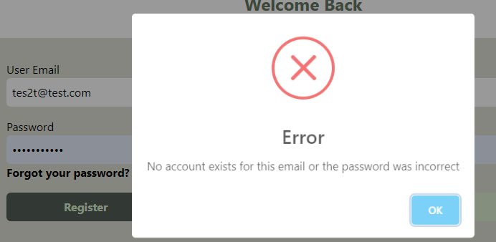
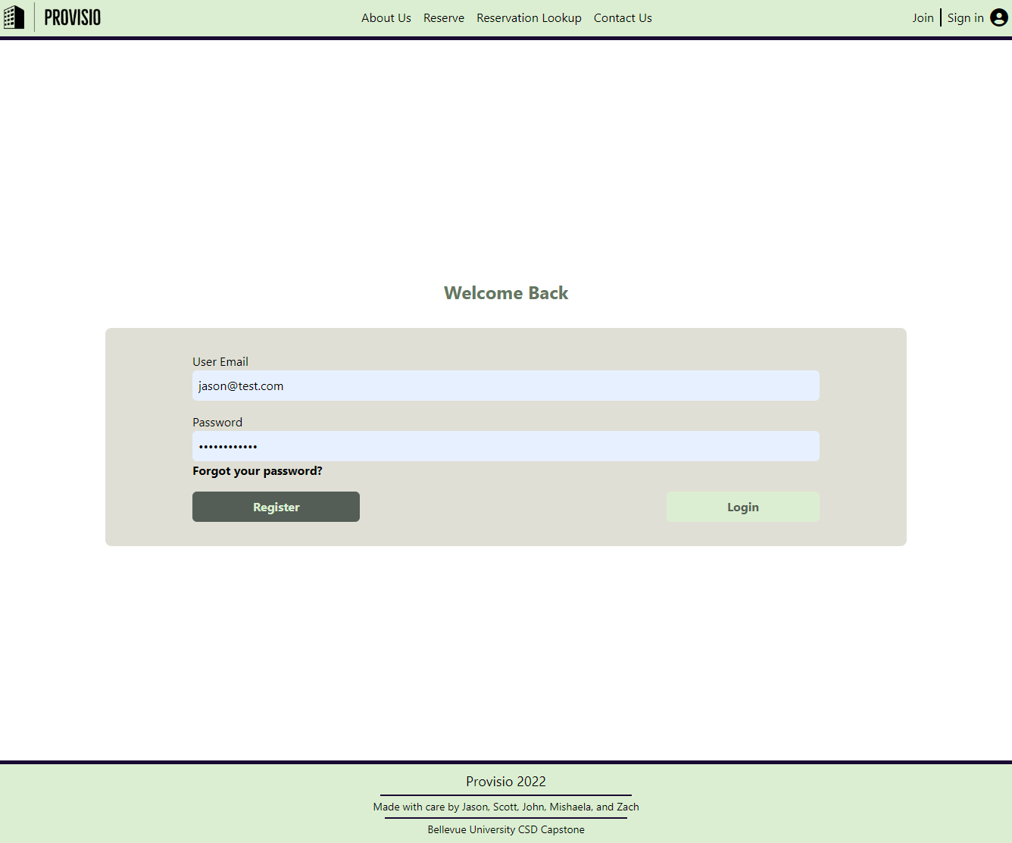
Login Page
Designed by: Scott (Finalized by John)
Similar to the Registration Page, the Login Page features a simple form for email and password. When submitting with invalid credentials, a popup appears telling the user what may have happened.

Slide 13
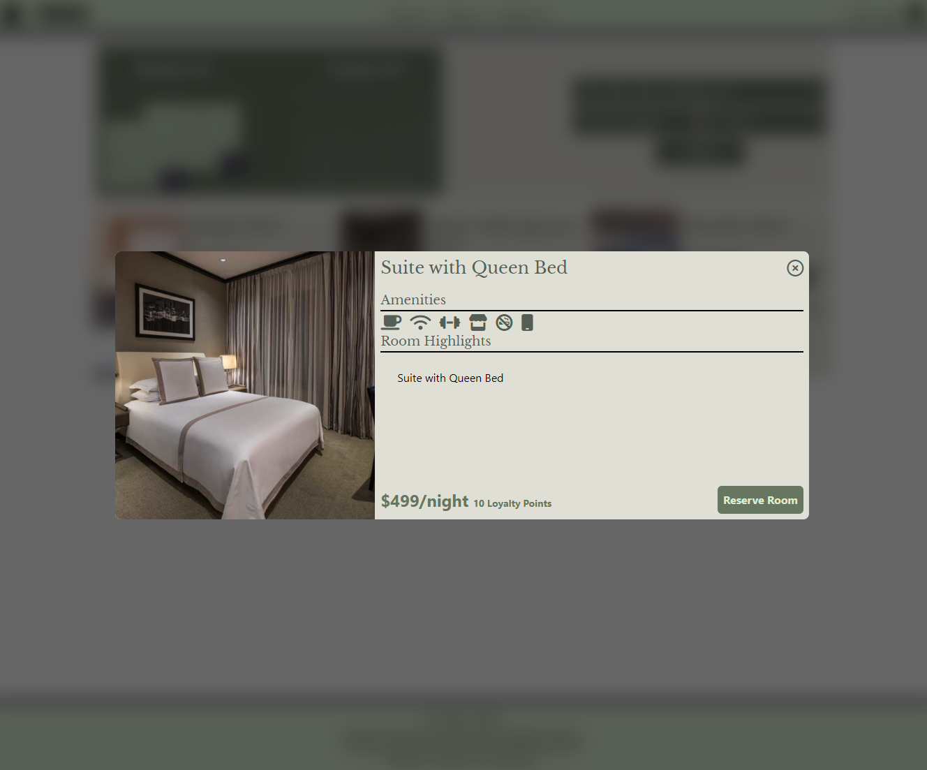
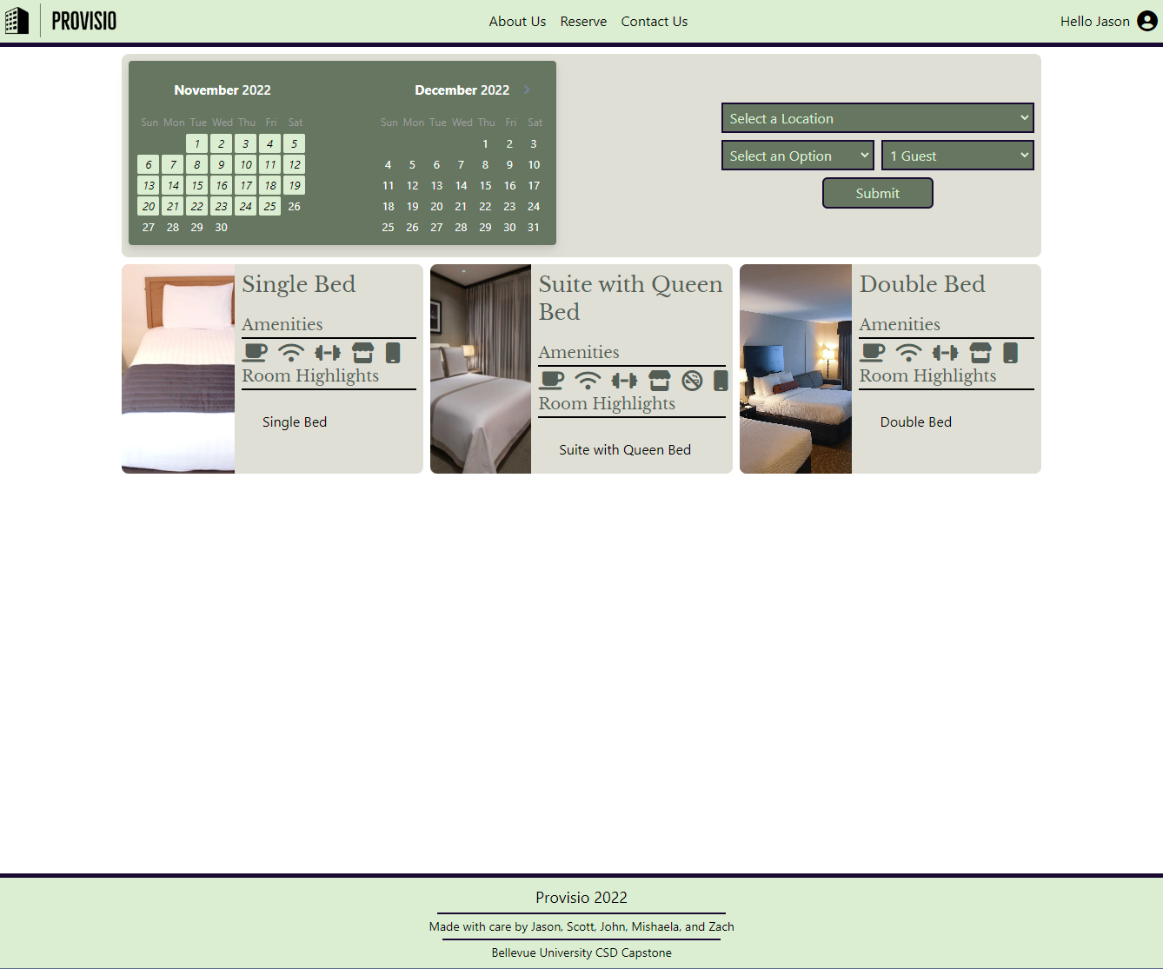
Reservation Page
Designed by: Jason
The Reservation Page features a tile system with each room being displayed. The user can sort by price, select a date, location, and amount of guests from the top bar. Upon clicking a room, a Modal opens with additional details.

Slide 14
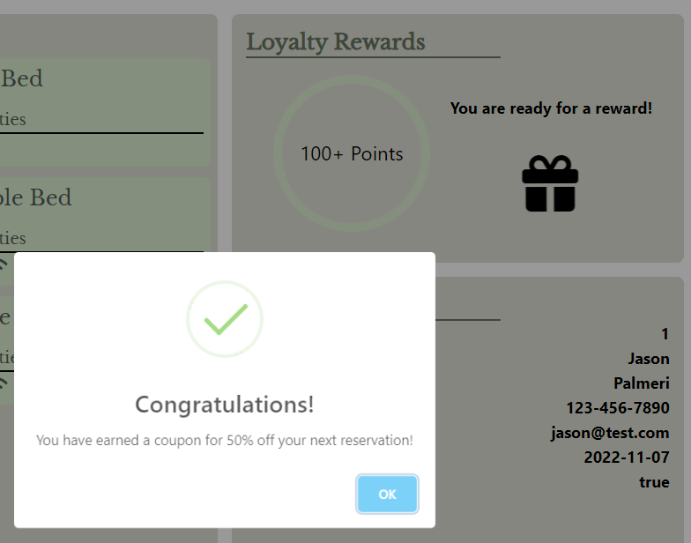
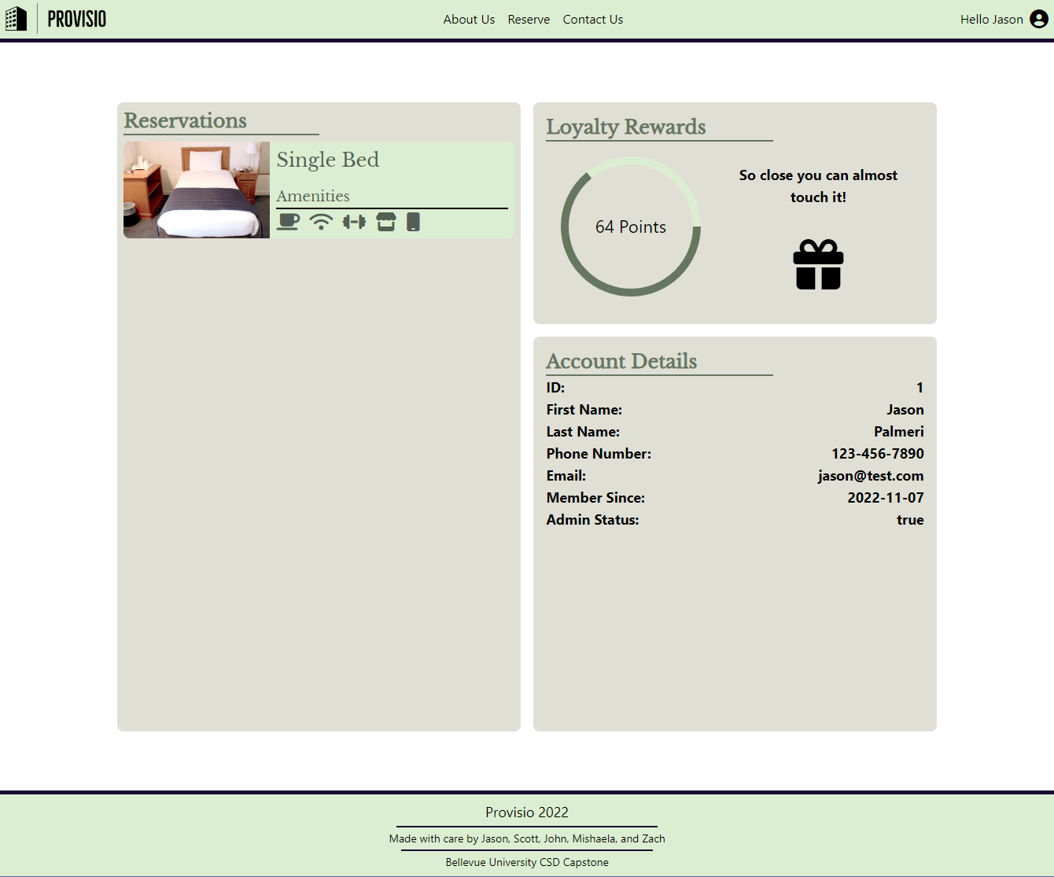
My Account Page
Designed by: Jason
The My Account Page is your one stop spot for Loyalty Points, Reservation Summary, and Account details. Clicking on a reservation opens a similar Modal to the Reservations Page, and at 100+ points you can open the gift to receive a coupon!

Slide 15
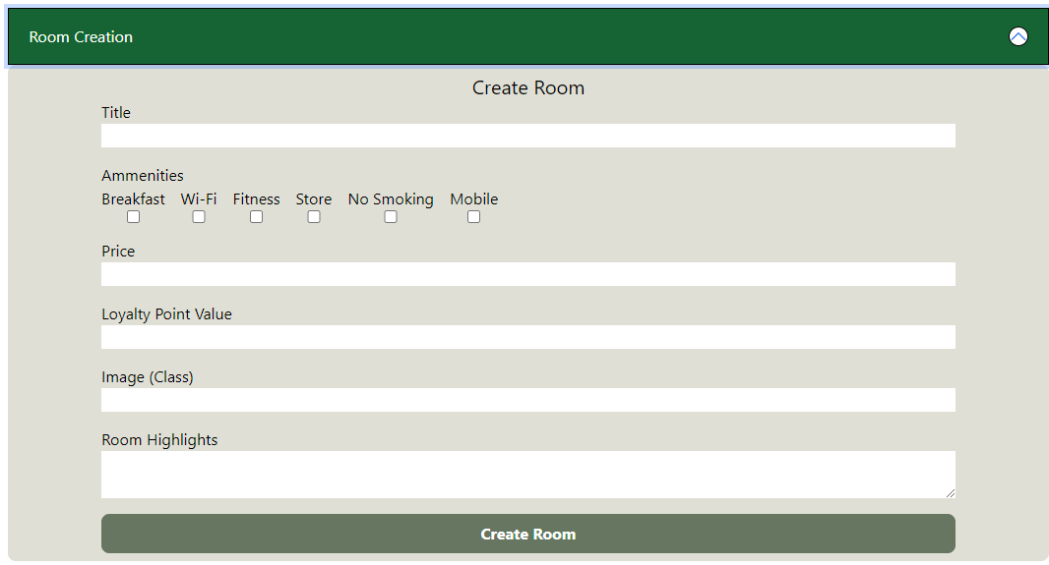
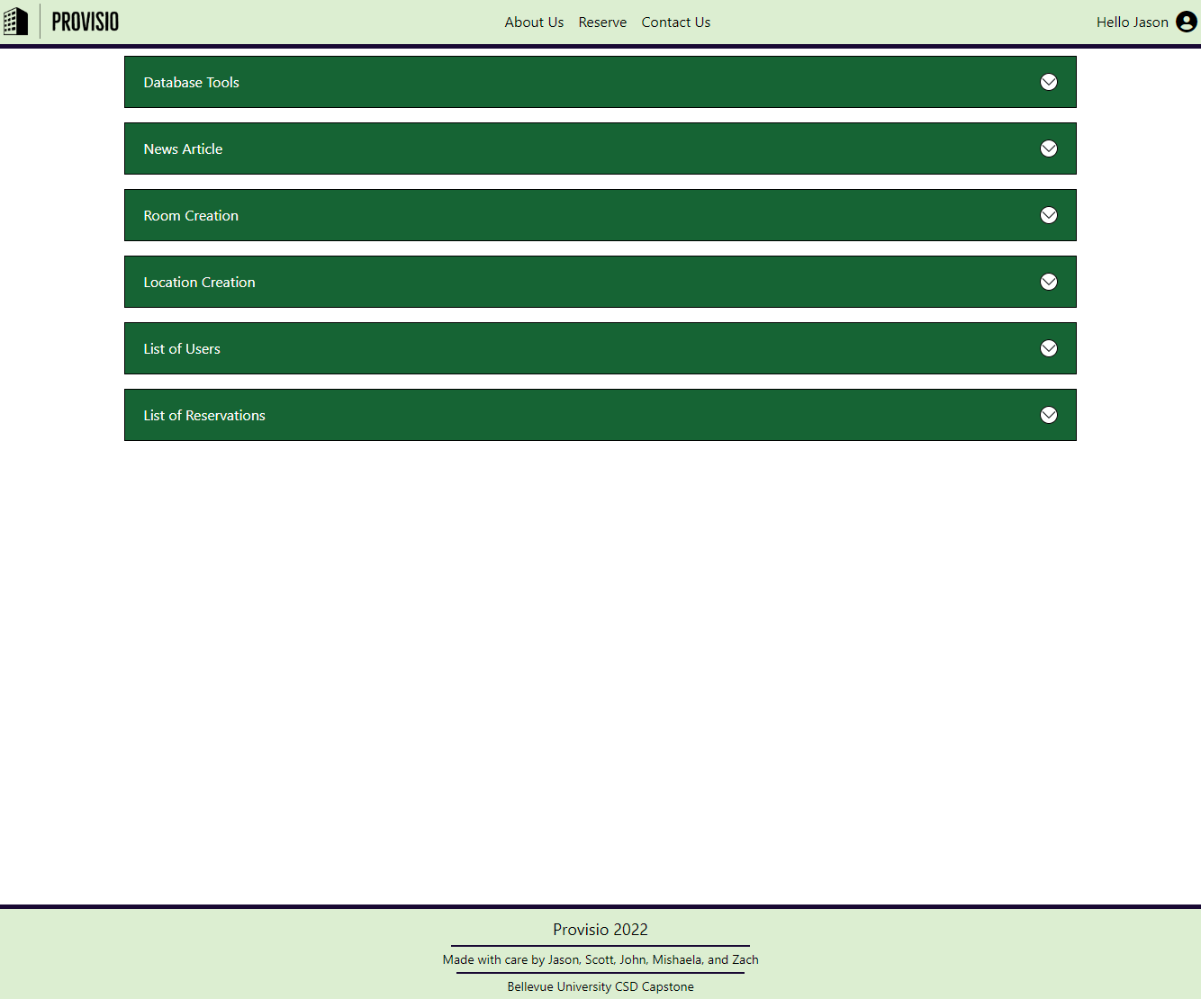
Admin Page
Designed by: Jason
The Admin Page features a set of tools to:
Reset the Database
Create News, Rooms, Locations
View a List of Users
View a List of all Reservations

